Slide 1




Recap & Recommendation
SheildGruppe Controls & Systems Audit
By Sayam Ray

Slide 2
Executive Summary:
Overview
Analyses of the Contract validation in Both Retail & Corporate sector in terms of Involvement, Transactions and Policies.
Evaluation of the Information systems matrix for the further preparation of the controls audit.
Preparation of the Risk Assessment Matrix.
Recommendations

Slide 3
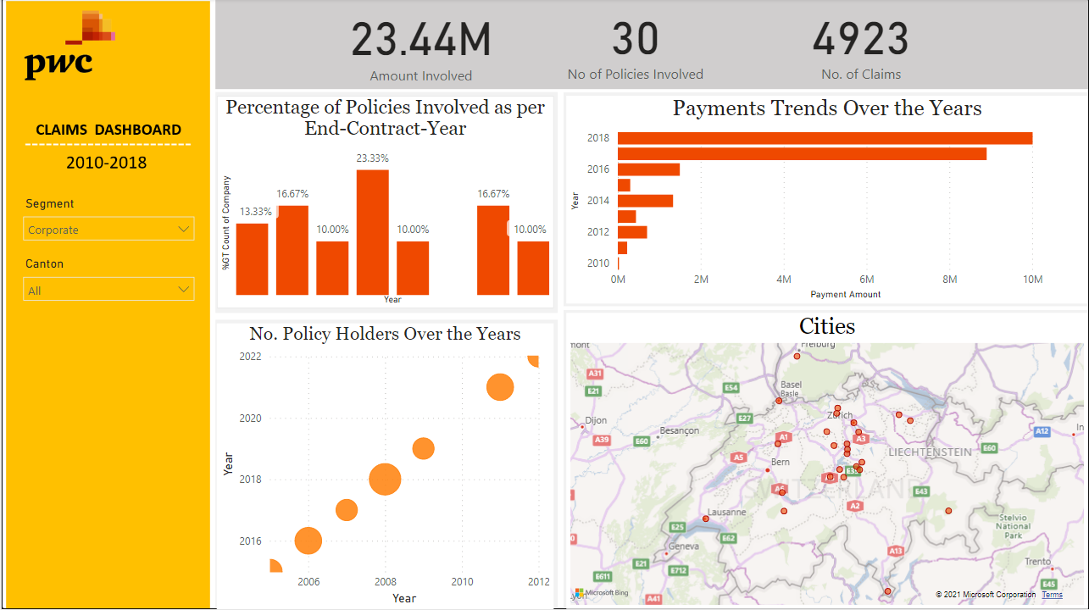
Insights from Data Analysis(Corporate Segment):
Highlights:
On analyzing the percentages of the policies in which the companies were involved by End Year Contract 2018 has shown almost 23.33%.
Inclination of Higher payment trend along with almost 30 policies and 4923 Claims overall both the segments included.

Slide 4
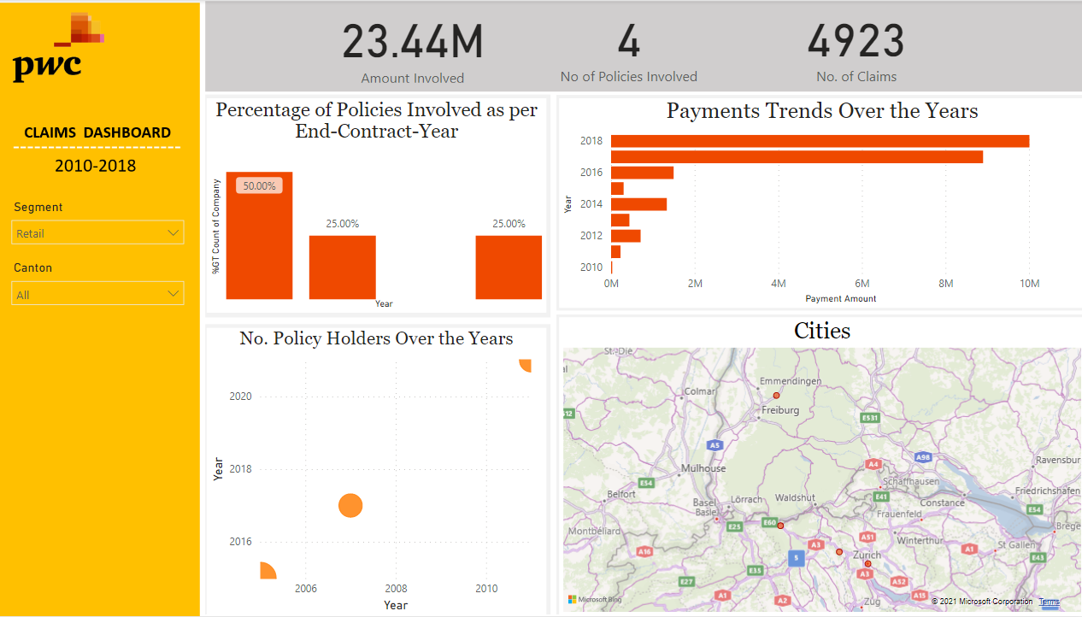
Insights from Data Analysis(Retail Segment):
Highlights:
On analyzing the percentages of the policies in which the companies were involved by End Year Contract 2015 has shown almost 50%.
Involvement of almost 4 Polices in 4 major cities

Slide 5
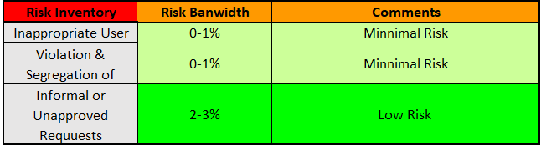
Risk Assessment:
Highlights:
On analyzing the Risk Bandwidth of the Risk Inventory present it was found to in between Minimal to Low Risk.

Slide 6
Recommendations:
Periodic Review of the policies and Prrocess
Reconciliation of the accesses, approval and user defined values.
Authenticity checking.
Timeframe activity.

